Slide 1
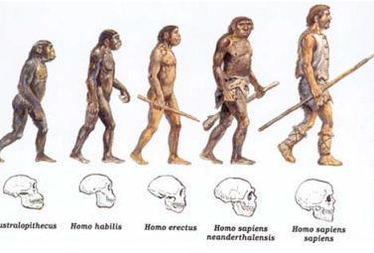
Prehistoric Humans

Slide 2
Human Origins
•Scientists do not all agree about the story of human beginnings.
•One generally accepted theory is that hominids were the first humans, dating back 4.4 million years.
•These hominids are known as Australopithecus.

Slide 3
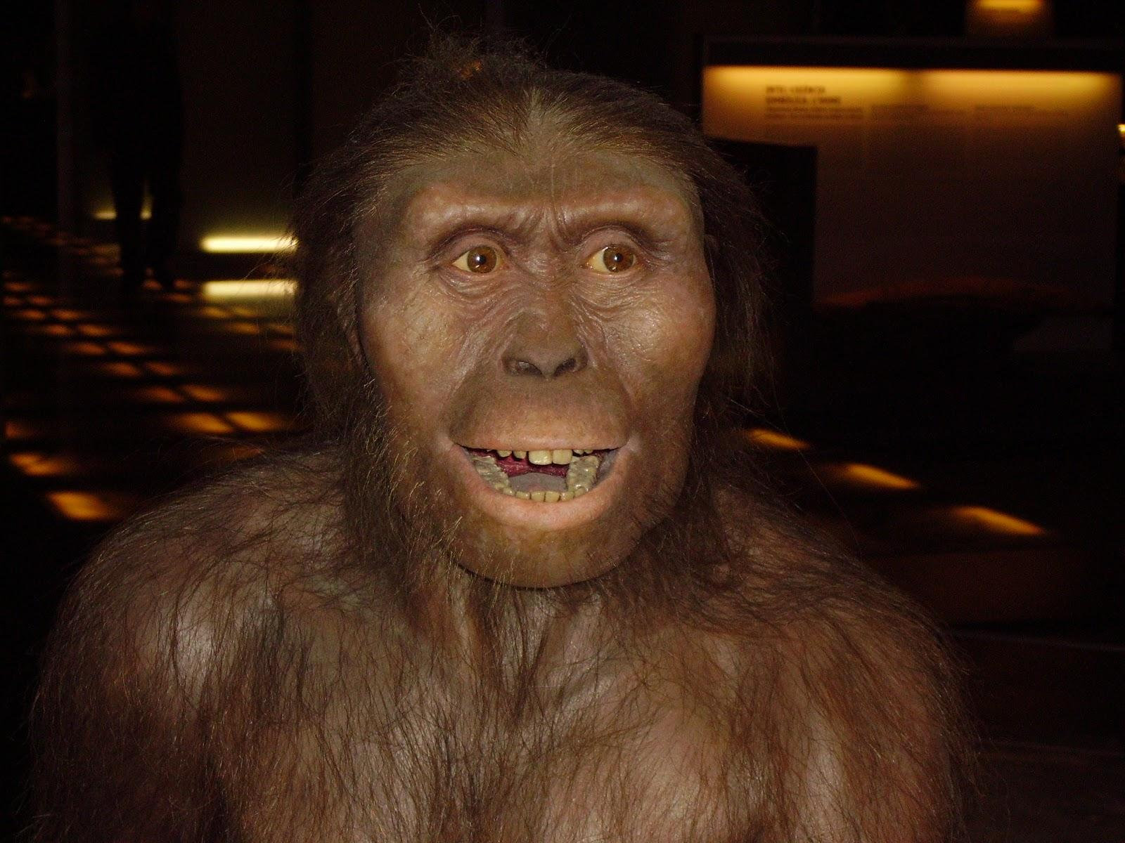
Australopithecus
The name means: “southern ape”
Australopithecus spent their lives in the humid forests of eastern and southern Africa around 4,4 mya
They ate fruit, leaves, and nuts.
They were probably nomads, never staying in one place for long
Their brain was ⅓ of the size of modern human brain
They did not use tools yet.

Slide 4
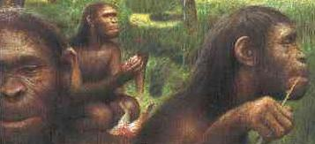
Homo Habilis
The name means:-”handyman”,”person with abilities”
They lived around 2,4 mya to 1,5 mya
They started using simple tools for chopping.
Their brain was ½ the size of a modern human’s

Slide 5
They were hunter-gathers
Oldest hominids known to create tools
Lived in Africa from about 2.5 to 1.5 million years ago
Lived alongside the Australopithecus
Just making sounds and signals to show emotion and direction

Slide 6
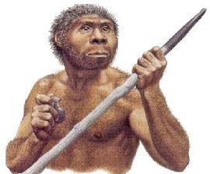
Homo Erectus
The name means: “upright man”
First appeared in Africa & lived from 1.6 million to about 250,00 years ago.
Learned to make fire
Made clothing for themselves

Slide 7
Homo erectus people migrated from their Native Africa to Europe and Asia.
Skeletal remains prove that they lived in China only 460,000 years ago and in Europe 400,000 years ago.
Homo erectus may have been talking to each other about 500,000 years ago

Slide 8
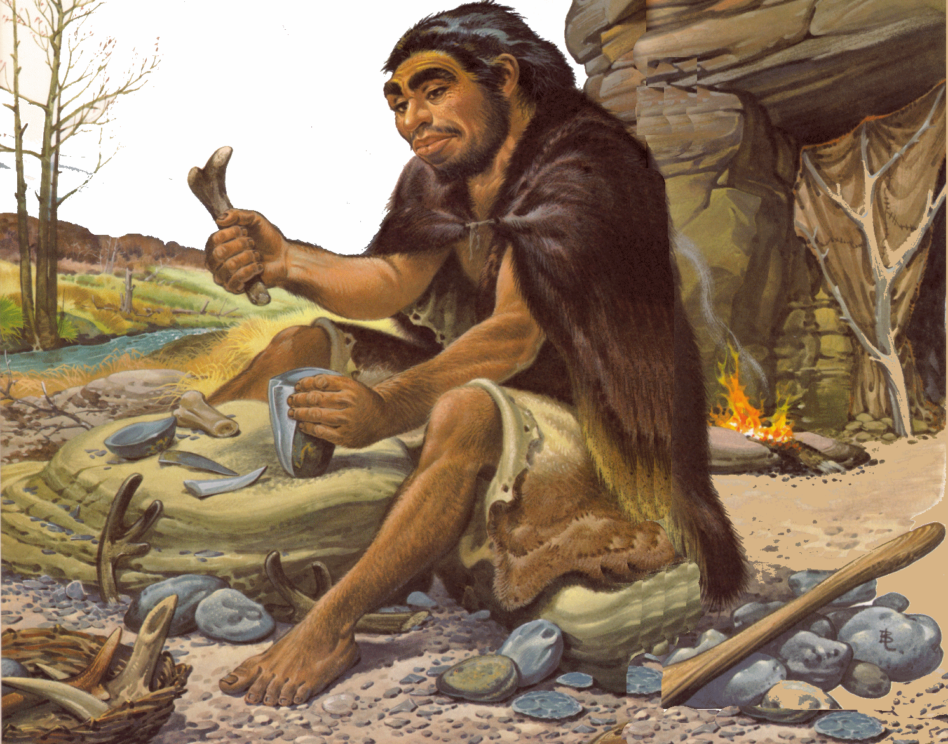
Homo Sapiens
Evidence of early Homo sapiens goes back as far as 200,000 years ago.
Neanderthals - most likely the first Homo sapiens
Neanderthals stood about 5.5 feet tall, their brains were slightly larger than modern humans, and their bodies were stocky.

Slide 9
Used fire for warmth and cooking
Skillfully constructed stone knives, spear points, and bone tools;Crafted hide-cleaning and food-preparing tools
Most lived in small groups of 35 to 50 people
Were nomads, therefore did not live in one place permanently
Lived in caves or overhangs from cliffs

Slide 10
Homo Sapiens Sapiens
Lived in Africa some 50,000 years ago
More advanced than Homo sapiens
Within 20,000 years ago, this modern group had migrated to almost every continent of the world
As these people moved out of Africa, they intermarried with Neanderthals

Slide 11
Earliest Homo sapiens sapiens
Their remains were first found in France around 1860
Cro-Magnons were taller and less stocky than Neanderthals
Improved technology development
More sophisticated culture

Slide 12
Cutting blades were thinner and sharper
Created fishing devices and needles for sewing
Invented the stone ax in order to cut down trees and make canoes
Invented the spear-thrower and the bow and arrow
By 15,000 B.C. human population stood at about 2 million

Slide 13
Neanderthals cared for their sick and elderly
May have been the first people to practice medicine
Believed in life after death
Practiced burial rituals

Slide 14
Lived in bands, with many different bands spread throughout
Bands had to work together to hunt
Rules were developed for people to get along and for work to get done
Leaders were named and placed in charge of enforcing rules
First political organizations formed

